Slide 1
Evaluation of antiepileptic drugs
Submitted by:
Shaema M. Ali

Slide 2
A seizure is a clinical symptom or sign caused by abnormal electrical discharges within the cerebral cortex.

Slide 3
By contrast, epilepsy refers to the clinical syndrome of recurrent seizures, and implies a pathological state that predisposes to further future seizures.

Slide 4
Epilepsy affects 0.5-1% of the general population. This may remain localized (focal seizure) or may spread to cause a secondary generalized seizure, or affect all cortical neurones simultaneouusly (primary generlized seizure).

Slide 5
Practical guide to antiepileptic drugs
1-When to initiate
following a single seizure, anticonvulsants are not generally prescribed, whereas after two or more distinct seizure episodes (i.e. with more than a few weeks apart between episodes), they generally are prescribed.

Slide 6
2- Monotherapy
Initial therapy is confined to a single drug (i.e. monotherapy) that is usually effective in stopping seizures or at least significantly decreasing their frequency.

Slide 7
The majority of epilepsy patients (70%) can remain on monotherapy for adequate control, although sometimes the choice of monotherapy may need to be switched to allow for tolerance or optimisation of seizure control.

Slide 8
3- What drug to initiate
Depending primary on seizure type, because in certain cases the spectrum of seizure efficacy is limited, and, moreover, certain seizure types can be worsened by ill-chosen drugs.

Slide 9
For example, carbamazepine is an effective first-line therapy for partial seizures but may worsen absence or myoclonic seizures.
similarly phenytoin can worsen absence and myoclonic seizures. Ethosuximide, by contrast, is only effective in primary generalised, and not partial, seizures.

Slide 10
4- Age and sex
This is particularly true of women, who avoid drugs associated with teratogenesis, ex. Valproate or that have adverse effects on their appearance, ex. Hirsutism from phenytoin.

Slide 11
4- Polytherapy
If a trial of three or so successive anticonvulsants (i.e. taken as monotherapy at adequate dosage for at least several months) does not control a patient's epilepsy, it may be worthwhile trying dual therapy.

Slide 12
5- Abrupt withdrawal
6- Circumstantial seizures

Slide 13
Pregnancy and epilepsy
One of the main concerns in this patient group is that all anticonvulsants increase the chance of teratogenicity, with valproate, and phenobarbital carrying most risk.

Slide 14
The toxicological hazard must be weighed against the risk of seizures which themselves can be harmful to mother and unborn baby, and are likely to worsen if anticonvulsants are discontinued.

Slide 15
Breast feeding
Antiepilepsy drugs pass into breast milk: phenobarbital, primidone and ethosuximide in significant quantities, phenytoin and sodium valproate less so.

Slide 16
Epilepsy and oral contraceptives
Many antiepileptic drugs induce steroid-metabolising enzymes and so can cause hormonal contraception to fail. This applies to: carbamazepine, oxcarbazepine, phenytoin, barbiturates, and topiramate

Slide 17
Note: Lamotrigine is not an enzyme inducer but can decrease levonorgestrel plasma concentration through other mechanisms

Slide 18
Epilepsy in children
Treatments are similar to those used in adults, but certain seizure types necessitate drugs that are rarely used in adults, e.g. ethosuximide for absence seizures, or vigabatrin for refractory partial seizures (partly because children may become irritable or more cognitively impaired with drugs such as valproate and phenobarbital).

Slide 19
Status epilepticus
Treatment of seizures is initially with the intravenous benzodiazepine lorazepam (0.5–4 mg). Lorazepam is preferred to diazepam because it has a longer effective t½ and is less lipophilic and so accumulates less in fat, causing less delayed toxicity (hypotension and respiratory depression)

Slide 20
Phenytoin I.V. may be started simultaneously to suppress further seizures, given as a loading dose (15–20 mg/kg body-weight) over 1 h
Phenobarbital may be given I.V. as a third-line drug when seizures continue.

Slide 21
If resuscitation facilities are not immediately available, diazepam by rectal solution is a useful option. In some cases, midazolam (nasally) may be preferred, e.g. in children or those with severe learning disabilit

Slide 22
Magnesium sulfate is the treatment of choise for seizure related to eclampsia.

Slide 23
Important note
-First line drugs are carbamazepine and sodium valproate
-Alternative monotherapy Lamotrigine, oxacarbazepine, topiramate… etc
-As part of combination therapy Gabapentine, , tiagabine, vigabatrin.

Slide 24
Treatment of partial seizures (simple, complex, with or without secondary generalization)
Preferred monotherapy carbamazepine
Alternative: valproic acid, lamotrigine and levetiracetam

Slide 25
Treatment of generalized seizures
• Preferred monotherapy Sodium valproate and lamotrigine are effective against all the generalized seizures.

Slide 26
Alternative monotherapies Depend on seizure type.
Tonic-clonic levetiracetam.
Absence Ethosuximide.
Myoclonic Clonazepam.

Slide 27
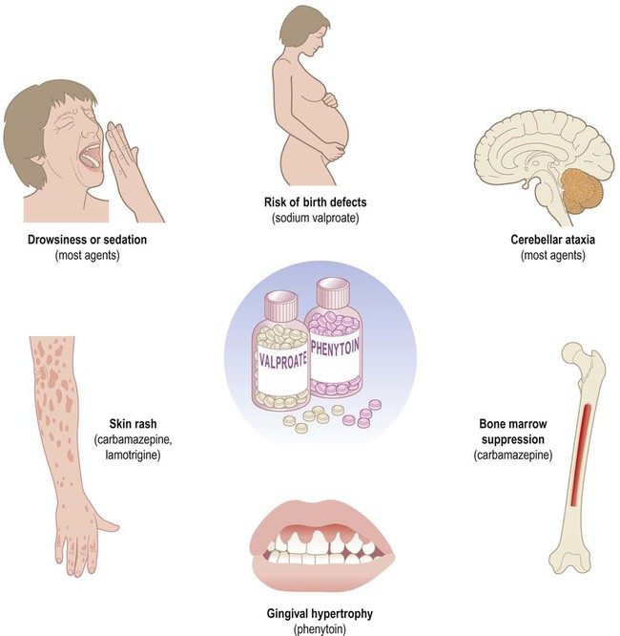
Side effects of AEDs

